Slide 1
Django
https://www.djangoproject.com/
Introduction + Installation
Django Apps and Projects
Models + the DB API
The Admin Site
Views & URLs
Templates + Inheritance
Notes:
http://www.w3schools.com/html/default.asp

Slide 2
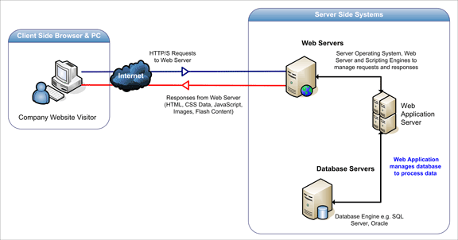
Intro – Web Applications
Figure from http://www.acunetix.com

Slide 3

Django
Django is a High-level Python web framework for rapid development
It follows the MVC architecture:
Model: The data, which defines the app’s objects and relationships
View: The visual representation of the data. Multiple views of the same information are possible
Controller: Accepts user input and converts it to commands for the model
Used by Instagram, Pinterest, Disqus, Mozilla & many more

Slide 4
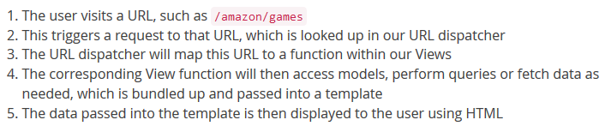
Django Apps Workflow
URL
View Function (Python)
URL Dispatcher
Accesses the DB using Models (Python Classes)
View Function processes data & sends it to
Template (Dynamic HTML page)

Slide 5
Design Philosophies & Concepts
Loose Coupling: The framework’s layers shouldn’t “know” about each other unless absolutely necessary
MVC supports loose coupling between the layers
The data is separated from the logic that manipulates it
The logic is separated from the UI
Loose coupling between URL structure & functionality
Less Code, Quick Development: Django takes care of most aspects of web development for us
DRY (Don’t Repeat Yourself): Django allows code reuse, common cases are easily dealt with
Template inheritance removes design redundancy

Slide 6
What’s Included in Django?
An ORM (Object Relational Mapper) system
This is a layer of abstraction to the database
We don’t need to create DB tables or use SQL Queries
We write Python classes and Django deals with the DB!
Templates: for designing UI separated from the logic
A Built-in Admin Site: Allows us to make CRUD operations on the DB easily
A Built-in & Lightweight Web Server
A URL Mapping System for elegant URL design
Lot’s of middleware & packages: Authentication, Forms, Security, Validation, Caching, Testing & more…
Notes:
CRUD – create, read, update and delete

Slide 7
Installing Django
Setting the PATH system variable
Right Click My Computer → Advanced System Settings → Environment Variables → In System Variables edit PATH and add ;C:\Python34;C:\Python34\Scripts
Check the doc for cmd instructions
Installing Setuptools
Download ez_setup.py to C:\Python34\Scripts
Run it from cmd (python ez_setup.py)
Installing Django using pip, Python’s package manager
Run the command: pip install django
Run the command: django-admin --version
This checks the installation version
Notes:
במחשבים של אפקה מותקן פייתון 2.7 ולכן המערכת מזהה אותו לפני פייתון 3.4! .
נצטרך באופן ידני להסיר את פייתון 2.7 ולהכניס לנתיב/PATH את פייתון 3.4 כפי שנאמר בשקף זה.
בעבודה במחשב הביתי, אין צורך מאחר וסביבת העבודה אמורה להיות מוכנה כחלק מההתקנה של פייתון 3.4 ומעלה.
*ניתן לפתוח טרמינל(ב"מ ב-pycharm זה ה-CMD) ע"י ALT-F12 , ולעשות את כל הפקודות ממנו בהמשך הפרוייקט.
*בנוסף אם נעתיק, שים קיצור דרך של CMD בתיקייה מסויימת ונפתח אותו משם הנתיב יהיה עד לאותה ספרייה כלומר לא נצטרך לעשות CD עד אליה!

Slide 8
Creating a Django Web App
In this presentation we will go through the necessary steps to create a Django web app (a polls app)
The lessons are interactive, we will build the app together, live
Create a directory for Django projects
In the cmd, cd to this directory
Run django-admin startproject mysite
This will create a mysite/ directory
Notes:
חלק זה ניתן לעשות דרך ה-pycharm מה שמקל על העבודה עם ה-cmd דהיינו העבודה עם ה-cmd תהיה דרך pycharm והכל יהיה מרוכז, פתיחת טרמינל דרך pycharm אוטומטית תעשה cd לתיקיית העבודה הרצויה!
שלבים:
-יש ליצור תיקייה לאיחסון הפרוייקט
-דרך pycharm לפתוח תיקייה זו. אומנם אין בה קבצי פייתון וכולי אבל pycharm פשוט יפתח חלון עבודה חדש עם תיקייה זו.
-ALT+F12 פותח cmd (ב"מ) שכבר נמצא בתיקייה זו!
-ניתן להמשיך עם השלבים במצגת דרך הטרמינל ביתר נוחות!!!

Slide 9
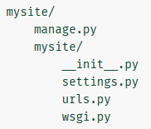
Project Files Structure
The outer mysite/ dir is the root directory
Can be changed to any name, it is not in use by Django
manage.py: A command-line utility that lets us interact with this Django project
The inner mysite/ dir is the actual Python package for our project
we’ll need to use this name for imports (e.g. mysite.urls)
mysite/__init__.py: An empty file telling Python that this directory is a Python package

Slide 10
Project Files Structure
mysite/settings.py: project settings, configuration
mysite/urls.py: the URL declarations for the project
It is a “table of contents” of our Django site
mysite/wsgi.py: an entry-point for WSGI-compatible web servers to serve your project
The Web Server Gateway Interface (WSGI) is a Python specification for a universal interface between web servers, web applications, or web frameworks
Django is compatible with this standard

Slide 11
Database Setup
Open mysite/settings.py & locate the DATABASES dict
Django officially supports 3 database engines: PosrgreSQL, MySQL and SQLite
Other engines, including MS SQL Server, are supported by third-party packages
The ENGINE and NAME keys at default defines the DB
SQLite is the easiest choice – it saves the DB as a file on our file system and does not run another process
The NAME is actually the DB filename
os.path.join(BASE_DIR, 'db.sqlite3') stores the file db.sqlite3 in the project’s directory
SQLite should not be used for production servers

Slide 12
Installed Apps
While in setting.py, change USE_TZ to False
On windows we rely on the system’s time zone
Take a look at the INSTALLED_APPS tuple
An “app” is a reusable piece of code
Apps can be reused on many projects
The apps that are listed here are activated in our project
This modularity allows us to create “apps” of our own and reuse them in many projects
Apps can be shared among different developers
Django includes many useful apps built-in

Slide 13
Installed Apps (2)
When we create a project, the following commonly used apps are activated by default:
django.contrib.admin – The admin site
django.contrib.auth – An authentication system
django.contrib.contenttypes – A framework for http content types
django.contrib.sessions – A session framework
django.contrib.messages – A messaging framework
django.contrib.staticfiles – A framework for managing static files

Slide 14
Installed Apps DB
Some of these apps make use of database tables
We need to create those tables before using them
To do that, run: python manage.py migrate
The migrate command creates any necessary DB tables according to the settings in our mysite/settings.py file
It might also contain DB migrations (we’ll see this later)
There should be a message for each migration it applies
Run sqlite3 db.sqlite3 to open SQLite’s CLI and run:
.tables to see all the created tables
.schema to see the query for creating the DB
.exit to exit the CLI

Slide 15
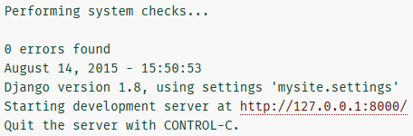
The Development Server
Let’s verify our Django project works
Run python manage.py runserver
You’ll see the following output on the command line:
It’s a built-in, lightweight web server written in Python
It aims to help us develop things fast and save the need to configure a production web server (like Apache, IIS)
Visit http://127.0.0.1:8000/ with your web browser
You should see a “Welcome to Django” page
Notes:
Break connection using: CTRL + c

Slide 16
Apps and Projects
Now that our environment, a project, is set up, we’re ready to start developing
Each app we write in Django consists of a Python package that follows a certain convention
Django creates the package’s directory structure for us
What’s the difference between a project and an app?
An app is a web application that does something
A project is a collection of configurations and apps for a particular website
A project can contain multiple apps
An app can be used in multiple projects

Slide 17
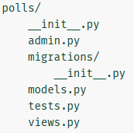
Creating an App
Apps can be created anywhere in the Python path
We’ll create our polls app right next to manage.py, so it could be imported as a top-level module, rather than a submodule of the mysite package
Make sure you’re in the same directory as manage.py
Run python manage.py startapp polls
That’ll create a directory called polls/
It will contain the following files & folders for our polls application

Slide 18
Models
Models are Python classes that represent the DB layout
Usually a model will have a single DB table
We also define relationships between models (tables):
One-to-One
One-to-Many (a.k.a., Foreign Key)
Many-to-Many
Django creates the DB for us and provides a DB API to retrieve, add, change & delete data without using/writing SQL queries
Can we change the DB(type) if we already have stored data?
This is what migrations are for!
An automatically generated history that Django uses to update our DB schema to match our current models

Slide 19
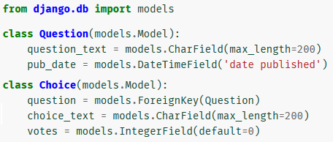
Creating Models
In our simple polls app, we’ll create two models:
A Question has a question text and a publication date
A Choice has a choice text and a votes counter
Each Question can have multiple Choices
Each Choice is associated with a single Question
Edit the polls/models.py file so it looks like this:

Slide 20
Creating Models (2)
Each model inherits from django.db.models.Model
Each model has a number of class variables representing DB fields
Why are these class variables and not instance variables?
Each field is represented by an instance of a Field class
CharField for character fields
DateTimeField for datetimes
The name of each Field instance (e.g. question_text or pub_date) is in machine-friendly format
We’ll use this value in our Python code
Our DB will use it as the column name
Notes:
אמרנו שהמחלקות/מודולים של פייתון יעזרו לנו בלהגדיר את הטבלאות של בסיס הנתונים הרצוי דהיינו בעזרת המודולים/מחלקות אנו קובעים את הסכמה/תצורה של הטבלאות ולכן יש לדעת מראש מה מרכיב כל טבלה כלומר מהם שדותיה! זאת הסיבה שנבחר את השדות בתור:
Class variables
ולא
Instance variables

Slide 21
Creating Models (3)
We can use an optional first argument to a Field to designate a human-readable name
We’ve only defined it for Question.pub_date
When not provided, the machine-readable name is used
Some Field classes have required arguments
CharField, for example, requires a max_length
That’s used in the DB schema, but also in validation
A Field can also have optional arguments
In this case, we’ve set the default value of votes to 0
Finally, note the ForeignKey relationship definition

Slide 22
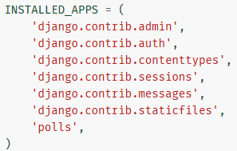
Activating Models
Now, we need to tell our project that the polls app is installed
Django apps are “pluggable”: You can use an app in multiple projects, and you can distribute apps
Edit mysite/settings.py by adding the string polls to the INSTALLED_APPS setting, so it’ll look like this:

Slide 23
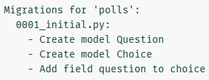
Migrations
Now run: python manage.py makemigrations polls
You should see something like this:
By running makemigrations, we’re telling Django that we’ve made changes to our models
The changes will be stored as a migration
Migrations are how Django changes our DB schema
They are saved in polls/migrations/0001_initial.py
We can manually tweak how Django changes things

Slide 24
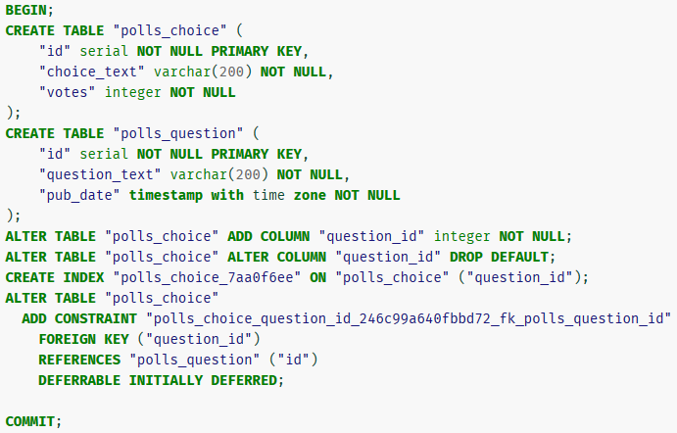
SQL Migrations Commands
We run the migrations with the command migrate
But first, let’s see what SQL that migration would run
Run python manage.py sqlmigrate polls 0001

Slide 25
SQL Migrations Commands (2)
The example above is for PostgreSQL, ours is different
Table names are generated by combining the name of the app (polls) and the lowercase name of the model – question and choice (this can be overridden)
Primary keys (IDs) are added automatically
Django appends "_id" to the foreign key field name
Database-specific field types such as integer primary key autoincrement (SQLite) or serial (PostgreSQL) are handled automatically
We can also run python manage.py check
This checks for problems without making migrations

Slide 26
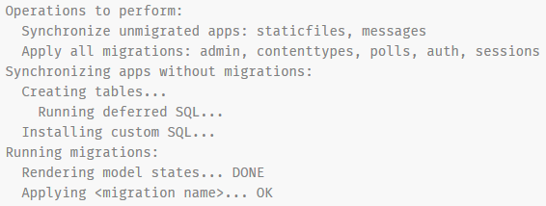
Making Migrations
Now, run python manage.py migrate
The migrate command synchronizes the changes we’ve made to our models with the DB schema
Django tracks which migrations were not applied yet using a special table in our DB called django_migrations

Slide 27
Migrations Summary
Migrations are very powerful
They allow us to change our models over time without the need to delete our DBs or tables and make new ones
They allow us to upgrade our DB without losing data
Remember the 3 steps for making model changes:
Change our models (in models.py)
Run python manage.py makemigrations to create migrations for those changes
Run python manage.py migrate to apply those changes to the DB

Slide 28
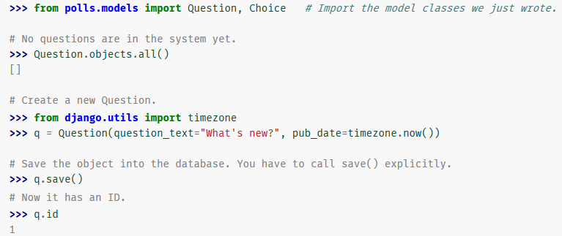
Playing with the API
Let’s run Django’s interactive Python shell
Run the command: python manage.py shell
Inside the shell, run the following code:

Slide 29
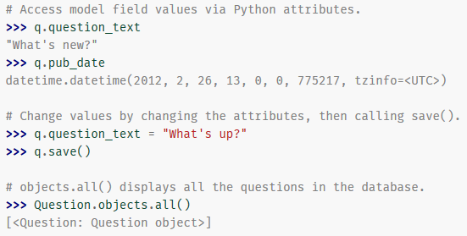
Playing with the API (2)
<Question: Question object>, the representation for Question, is not very helpful

Slide 30
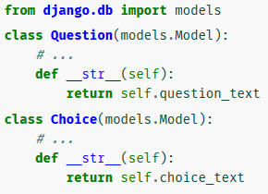
Adding a Textual Representation
Exercise: Fix the textual representation for Question and Choice
Solution: Add an __str__() method to each of them
It’s important to add __str__() methods to our models, not only for the interactive prompt, but also for the admin app

Slide 31
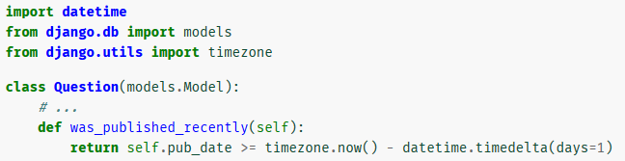
Adding a Custom Method
Let’s add a custom method, just for demonstration:
Save your changes to models.py
Exit the shell using exit() and run it again
(python manage.py shell)

Slide 32
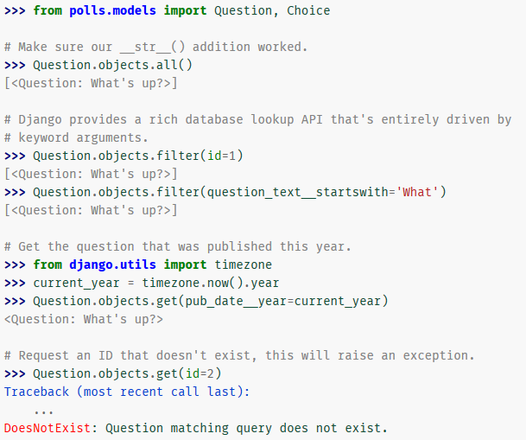

Slide 33
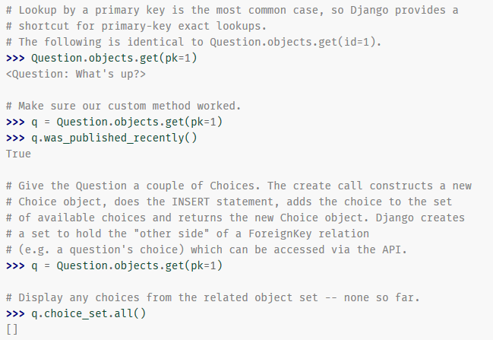

Slide 34
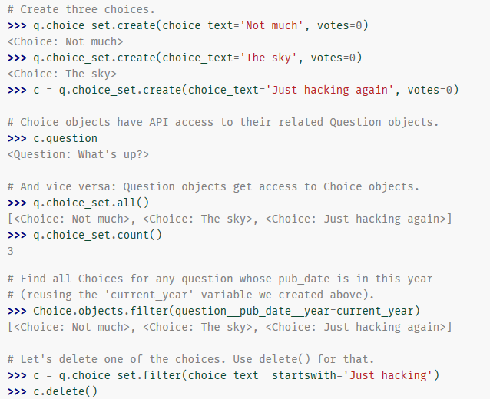

Slide 35
Field Lookups
Field lookups are the conditions for SQL WHERE
They’re specified as keyword arguments to the methods filter(), exclude() and get()
They have the form field__lookuptype=value
choice_text__startswith=‘J’
Common lookups: exact, startswith, endswith, contains
Lookups can span relationships between objects, taking care of the SQL JOINs behind the scenes
Combining lookups with AND: with commas
Combining lookups with OR: with Q objects
filter(Q(text__contains=“a”) | Q(text__contains=“b”))

Slide 36
The Admin Site
Motivation:
Building admin sites to edit content is tedious & boring
It only aims to add/change/delete content from the DB
Django automatically creates an admin site for us
Run python manage.py createsuperuser
Choose a username & password + email address
Start the dev server again
(python manage.py runserver)
Go to http://127.0.0.1:8000/admin/ and login
You should see something like…

Slide 37
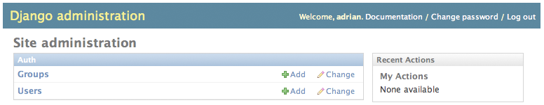

The Admin Site (2)
The Users and Groups are provided by Django’s authentication framework, django.contrib.auth
But where’s our poll app?
We need to define an admin interface to Question objects
Edit polls/admin.py to look like this:

Slide 38
The Admin Site (3)
Refresh the admin page, and click on Questions
This page displays all the questions in the DB
Click the “What’s up?” question to edit it:
The form is automatically generated from the Question model
The different fields (DateTimeField, CharField) correspond to appropriate HTML input widgets. Each type knows how to display itself in the Django admin
Each DateTimeField gets JavaScript shortcuts
Dates get a “Today” shortcut and calendar popup
Times get a “Now” shortcut and a convenient popup that lists commonly entered times

Slide 39
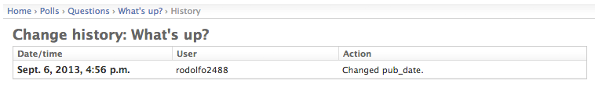
The Admin Site (4)
Change to “Today” and “Now”, then click “Save and continue editing”
Click “History” in the upper right corner
You’ll see a page listing all changes made to this object via the Django admin, with the timestamp and username of the person who made the change

Slide 40
Customize the Admin Form
By registering the Question model, Django constructed a default form representation
Sometimes, we’ll want to customize how the admin form looks and works
We can tell Django the options we want
In admin.py, replace admin.site.register(Question) with:
class QuestionAdmin(admin.ModelAdmin):
fields = ['pub_date', 'question_text']
admin.site.register(Question, QuestionAdmin)
This changes the order of pub_date ←→ question_text

Slide 41
Customize the Admin Form (2)
The pattern: create a ModelAdmin object, define the fields, and register the model with the ModelAdmin
Changing the order to forms with dozens of fields can greatly improve usability

Slide 42
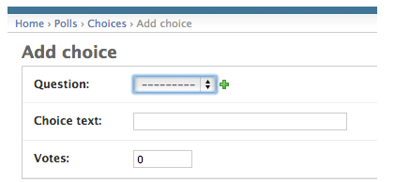
Adding Related Objects
What about choices? They do not appear in the admin
We can register Choice in admin.py:
from .models import Choice, Question
# ...
admin.site.register(Choice)
Now Choices are available at the admin
We can add a Choice and link it to a Question

Slide 43
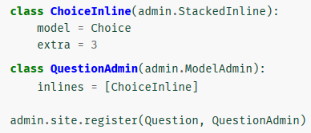
Adding Related Objects (2)
This is an inefficient way of adding Choice objects
It’d be better if we could add a bunch of Choices directly when we create the Question object
Remove the register() call for the Choice model
Edit the Question registration code to include:

Slide 44
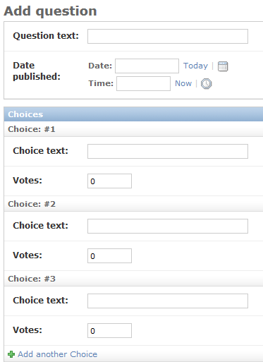
Adding Related Objects (3)
This tells Django: Choice objects are edited on the Question admin page
By default, provide the fields for 3 choices
The “Add Question” page should now look like:

Slide 45
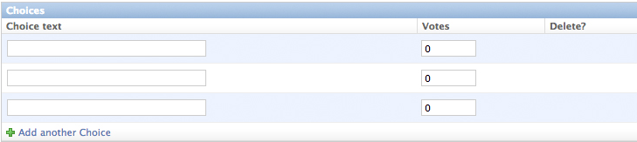
Adding Related Objects (4)
For a more compact view, we can change ChoiceInLine to inherit from admin.TabularInline
This creates a table view
The Delete? column is for added Choices or for values that have already been saved

Slide 46
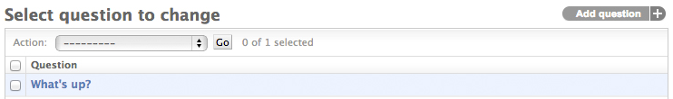

Customize the List Display
Let’s go back to the Questions page:
Django displays the __str__() of each question
It would be nice to also display other fields in the list
Add the following line to the QuestionAdmin class:
list_display = ('question_text', 'pub_date', 'was_published_recently')
This way we can display values of fields and methods

Slide 47
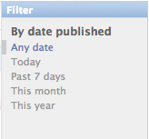
Adding Filters and Search
Add the following line to the QuestionAdmin class:
list_filter = ['pub_date']
Now we can filter by publication date
We can also sort the list by clicking a column
Add also the following line:
search_fields = ['question_text']
This allows searching the question text
The search performs an SQL Like and finds substrings
We can add more fields here to be searched

Slide 48
Views
A view is a web page that serves a specific function and has a specific template
Question: What should be the pages and actions for our polls app?
Questions “index” page – displays the latest questions
Question details page – displays a question text, with no results but with all the choices and a form to vote
Question results page – displays voting results for a particular question
Vote action – handles voting for a particular choice in a particular question

Slide 49
Views and URLs
In Django, views are matched with URLs
Each view is represented by a simple function/method
According to the requested URL, Django will choose the appropriate view (i.e., function/method)
You must have noticed non-pleasant URLs like: www.site.com/ME2/Sites/dirmod.asp?sid=&type=gen&mod=Core+Pages&gid=A6CD4967199A42D9B65B1B
Django allows much more elegant URL patterns
Example: www.site.com/newsarchive/<year>/<month>/
So how are URLs mapped to views? With URLconfs
A URLconf maps URL patterns (as REs) to views
Notes:
RE i.e. a regular expression

Slide 50

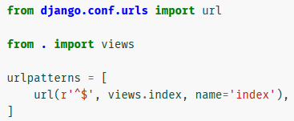
Writing Our First View
Open polls/views.py and put the following code in it:
To call the view, we need to map it to a URL
For this we need a URLconf
Create a file called urls.py in your app directory (polls/)
Insert the code:

Slide 51
Writing Our First View (2)
The next step is to point the root URLconf to the polls.urls module we just created
In mysite/urls.py insert the following to urlpatterns:
from django.conf.urls import url, include
url(r'^polls/', include('polls.urls')),
We have now wired an index view into the URLconf
Go to http://localhost:8000/polls/ and see the “Hello,…”
The url() function is passed 4 arguments
2 required: regex and view
2 optional: kwargs and name
Let’s review what these arguments are used for

Slide 52
The url() Function Args
regex: defines a regular expression to math the URL
It uses the re module that we already learned
^ matches the start of the URL, $ matches the end
The REs do not search GET and POST parameters, or the domain name
In the following example, myapp/ will be searched
http://www.example.com/myapp/?page=3
The order of definition is important
Django stops at the first match
If we define a loose pattern prior to a strict one, we might match the loose pattern and be directed to a wrong URL

Slide 53
The url() Function Args (2)
view: When Django finds an RE match, it calls the specified view function, with an HttpRequest object
“captured” values from the RE can be passed as additional arguments
kwargs: an optional dictionary of keyword arguments
We won’t use this argument on our example
name: Naming a URL lets us refer to it from anywhere in our Django project (especially templates)
This allows us to make global changes to the URL patterns of our project while only touching a single file
Notes:
בהמשך נראה שה-request object הוא זה שכולל בתוכו את כל יתר המחרוזת שבאה אחרי ההתאמה לדוגמא, האובייקט יכיל פרמטרים נוספים שנשלחו למשל ב-POST.
ולכן עבור חלק זה אל לנו לדאוג לאן הם נעלמו משום שהם בתוך האובייקט הנ"ל שישמש אותנו בהמשך.
מאחר ו-view הוא web page נרצה ב-template שלנו להפנות אולי לעמודים אחרים... ולכן נאמר, שהשם שניתן ל-view ישמש אותנו להפנייה/התייחסות לעמוד/view הרצוי בשמו ללא צורך בקוד שהוא hard coded אלא loose coupling .

Slide 54
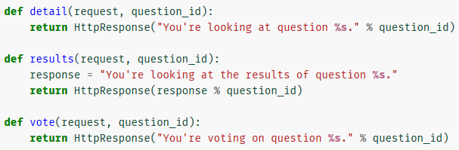
Writing the Other Views
Now let’s add the other views to polls/views.py
These views take an argument other than the request
The request object itself provides access to GET/POST parameters, cookies, session, the logged in user object
We’ll see how it’s used a bit later

Slide 55
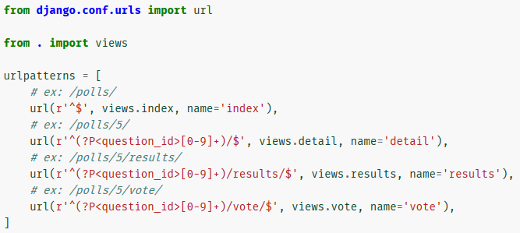
Connecting the Views to URLs
Define URL patterns to these views in polls/urls.py
Take a look localhost:8000/polls/34/. It runs detail() and displays the ID we provide in the URL (34)
Try “/polls/34/results/” and “/polls/34/vote/” too

Slide 56
The URLs←→Views Binding
When someone requests a page from our website, Django looks for the ROOT_URLCONF value in settings.py. In our case it points to mysite.url
Django goes to mysite/urls.py, looks for urlpatterns and traverses the REs
The include() functions reference other URLconfs
Note that the REs for the include() functions don’t have a $ (end-of-string match) but rather a trailing slash
Whenever Django encounters include(), it chops off the part of the URL matched up to that point and sends the remaining string to the included URLconf

Slide 57
URLs←→Views Binding Example
Suppose the requested URL was …/polls/34/
In mysite/urls.py, there is a pattern that matches polls/
The include() sends the remaining (34/) to polls.urls
This allows changing the URL structure to /fun_polls/ or /content/polls or whatever, and only change it here
polls/urls.py will match r'^(?P<question_id>[0-9]+)/$'
Patterns like (?P<name>...) are called named groups
(?P<question_id>[0-9]+) consists of the group ([0-9]+) that matches 34, and ?P<question_id> which defines the name of the matched pattern (question_id)
The matched pattern is sent to the view function (detail)

Slide 58
Writing Views that do Something
Each view is responsible for doing one of two things:
returning an HttpResponse object containing the content for the requested page,
or:
Raising an exception such as Http404 (page not found)
The rest is up to us:
We can read records from a database
We can use a template system to design the html
We can generate a PDF file, output XML, etc…
For example, let’s display the latest 5 poll questions separated by commas

Slide 59
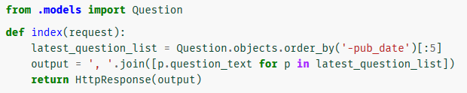
Writing Views that do Something
Edit polls/views.py to include:
Let’s add some questions to the DB and check it out
There’s a problem here, though: the page’s design is hard-coded in the view
If we want to change the way the page looks, we have to edit this Python code
So let’s use Django’s template system to separate the design from the Python code

Slide 60
Creating a Template
First, create a directory called templates/ inside polls/
In settings.py, within TEMPLATES, the backend is set to DjangoTemplates and APP_DIRS is set to True
DjangoTemplates looks for a templates/ dir in each of the INSTALLED_APPS
This is how Django knows to find the polls templates
Within the templates dir, create another dir called polls, and within that dir create a file called index.html
Our template file is polls/templates/polls/index.html

Slide 61
Creating a Template (2)
With this directory structure, we can refer to our template in Django as polls/index.html
If we had put it directly in polls/templates/ then Django might find an index.html file in another app
To avoid this, we’ll put each app’s templates in its own subdir and refer to it with that subdir in views:
polls/index.html,
admin/index.html,
app3/index.html,
…

Slide 62
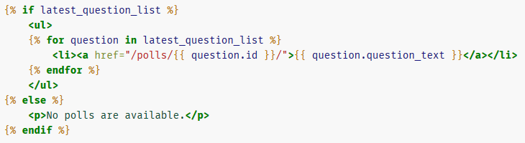
Editing the Template
Put the following code in the index.html template:
This piece of code contains both html and Django’s template language (everything in the {{ and {% tags)
This template language’s syntax is similar to Python and it’s evaluated to produce the final html page
Here we create a bulleted-list of the latest questions
Each bullet is a link to the question’s page displaying the question text

Slide 63
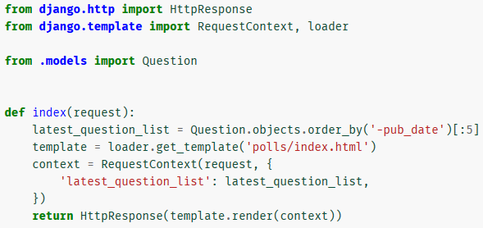
Using the Template
Now let’s update our index view to use the template:
This code loads the template called polls/index.html and passes it a context
The context is a dictionary mapping template variable names to Python objects

Slide 64
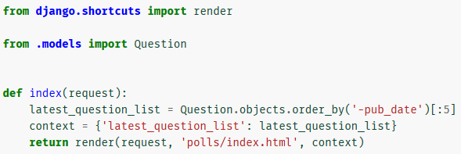
Shortcut: render()
The process we’ve just seen includes 3 steps:
Loading a template
Rendering the template with a context
Return an HttpResponse with the rendered template
Since this process is very common, Django provides a shortcut. Here’s the full index() view, rewritten:
Now we no longer need to import loader, RequestContext and HttpResponse.
Though currently we still need HttpResponse for the detail(), results(), and vote() methods.

Slide 65
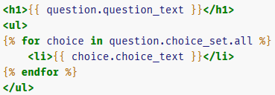
Question Details Template
Create a file called detail.html in templates/polls/
Put the following code in it:
It expects a Question variable
With this variable we can:
Access members (question.question_text)
Access methods (question.choice_set.all)
Note that in the template language methods are called without the () suffix
This returns an iterable of Choice objects to use in {% for %}
The template displays a header with the question text and a bulleted-list of all the choices

Slide 66
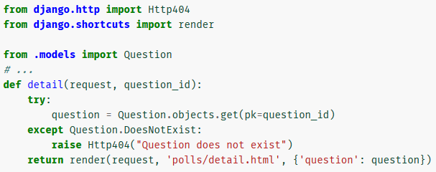
Question Details View
Edit polls/views.py to include the following:
The view gets a question_id, finds the Question object in the DB and renders the template with that Question
The addition here is the raise Http404() which raises an Http404 exception if the question id does not exist

Slide 67
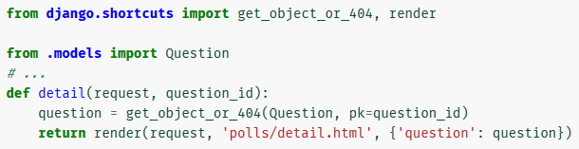
Shortcut: get_object_or_404()
It is very common to use get() and raise 404 if the object does not exist in the DB
Django provides a shortcut here, get_object_or_404()
Here’s the detail() view, rewritten:
The function takes a Django model as its first arg and any number of keyword args to be passed to get()
It raises Http404 if the object doesn’t exist
There’s also a get_list_or_404() function, which uses filter() instead of get(). It raises Http404 if the list is empty.

Slide 68
Avoiding Hard Coded URLs in Templates
In polls/index.html, the link was partially hardcoded:
Hard coded URLs causes the URL system and the templates to be tightly-coupled
Changing the URLs names or structure might require changes in many templates
To support loose coupling we can use the {% url %} tag
This is linked to the detail name we defined in polls.urls

Slide 69
Exercise: Changing the Templates
Change the templates and URL structure so that:
index.html would display:
All questions from the current year titled “New Questions”
All other questions titled “Old Questions”
The link to the new/old questions should be polls/new/<question_id> or polls/old/<question_id>
You can use:
filter(pub_date__year = 2015)
filter(pub_date__lt = '2015-01-01')
When finished, go back to before the change

Slide 70
Namespacing URL Names
In index.html we’ve used {% url 'detail' question.id %}
Currently our project only includes the polls app
In real-life we might use dozens of apps in one project
Recall that apps are reusable pieces of code
What if another app had a URL called detail?
To differentiate URL names we add namespaces to our root URLconf
In mysite.urls, change the polls line in urlpatterns to:
Add a polls: prefix in the link to ‘detail’ in index.html

Slide 71
MVC in Django
Question: What are the MVC components in Django?
Answer:
Model is Model, in Django it includes the ORM
A Django View is not really an MVC View
It does not define the visual representation
Along with the URL dispatcher, it’s the “glue” that takes the data from requests and activates Python functions
So, it is really the Controller
A Django Template is the MVC View
This is the visual representation of the data
So, when we translate the general MVC terminology to Django terms, we get MTV

Slide 72
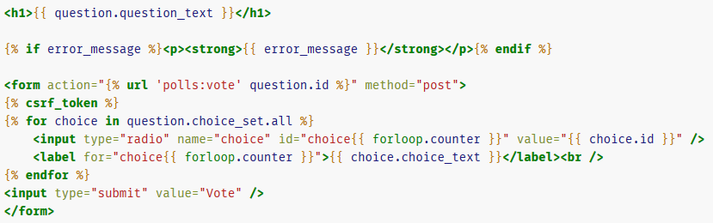
Writing a Simple Form
Let’s update detail.html to include an HTML <form> that will allow us to vote on a question:

Slide 73
Writing a Simple Form (2)
The form displays a radio button for each choice
Its name is "choice" and its value is the choice’s id
When the form is submitted, it’ll send choice=[id]
This is the basic concept of HTML forms
The form’s action is {% url 'polls:vote' question.id %}
The form’s method is “post”
It’s very important to use POST and not GET when submitting data that changes values in the server side
What values will be changed in our case?
This tip isn’t specific to Django; it’s just good web development practice
When using POST, we should defend against CSRF

Slide 74
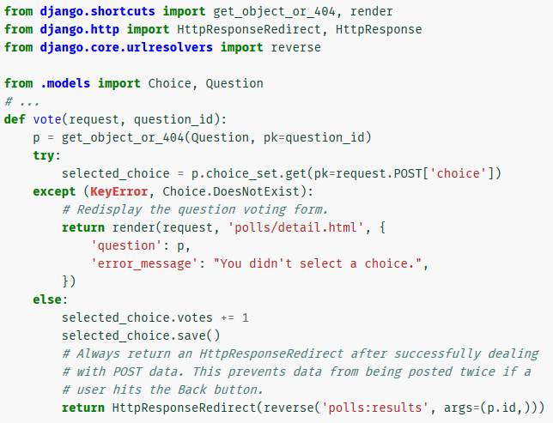
Dealing with Form Data
Let’s update our vote() function in polls.views:

Slide 75
Dealing with Form Data (2)
request.POST is a dictionary that lets us access submitted data by key name
In our case, request.POST['choice'] returns the value for the name 'choice' which is the ID of the selected choice
It’s a string; request.POST values are always strings
request.POST['choice'] will raise KeyError if choice wasn’t provided in POST data
The code redisplays the question form with an error message if choice isn’t given
We use HttpResponseRedirect to redirect the user to the results view and provide question_id in a reversed order
The URL will be /polls/3/results/ and not /polls/results/3/

Slide 76
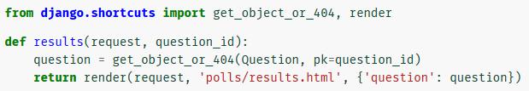
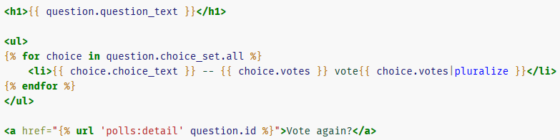
Editing the Results Page
Let’s edit the results() view, that is redirected by vote()
Now, let’s create its template (polls/results.html):

Slide 77
Shortcut: Generic Views
The index(), detail() and results() views represent a very common case in web development:
Getting some data from the DB according to a parameter passed in the URL
Loading a template
Returning the rendered template with the DB data
Because this is so common, Django provides a shortcut, called “generic views”
Generic views add another layer of abstraction to web development in Django

Slide 78
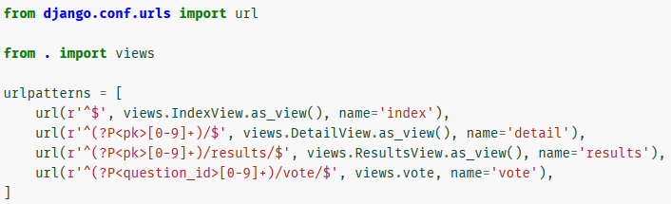
Change URLConf
Change the URLConf in polls.urls to look like:
We now point to IndexView, DetailView & ResusltsView
Note that the name of the matched pattern in the 2nd and 3rd REs has changed from <question_id> to <pk>

Slide 79
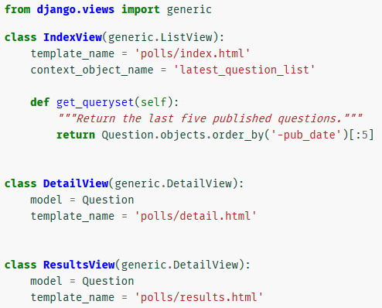
Defining Generic Views
Change polls/views.py to include this code: (you can keep the old views definitions)

Slide 80
Defining Generic Views (2)
We’re using two generic views here:
ListView that abstracts “display a list of objects”
DetailView that abstracts “display a detail page for a particular type of object”
Generic views need to know what model they will use
This is provided using the model attribute
It is not defined in IndexView since we extract the DB data ourselves in get_queryset()
generic.DetailView expects the value from the URL to be called "pk" so we’ve changed it in urls.py

Slide 81
Defining Generic Views (3)
By default, generic.DetailView uses a template called <app name>/<model name>_detail.html
We defined template_name = 'polls/detail.html' for DetialView and 'polls/results.html' for ResultsView
Otherwise, 'polls/question_detail.html' would have been used for both of them
In the previous views we used context variables
For generic.DetailView the context variable name is derived automatically from the model (Question)
For ListView we define the context_object_name attribute to override Django’s default value
The default value is question_list

Slide 82
Dealing with Static Files
Aside from the HTML generated by the server, web applications need to serve additional files
Examples: Images, JavaScript, CSS, etc.
They are necessary to render the complete web page
In Django, these files are called “static files”
For small projects we can just keep those files in some place that our web server can find (e.g: templates/)
In bigger projects, with multiple apps, it’s trickier to deal with all the static files provided by each app
django.contrib.staticfiles collects static files from each app (and any other places we specify)

Slide 83
Customize the Look & Feel
Create a dir called static/ in our polls/ dir
Django will look for static files there, similarly to how it finds templates inside polls/templates/
Django looks for static/ in each of the installed apps
Within static/ create another dir called polls/
Inside that dir create a file called style.css
The file’s path is: polls/static/polls/style.css
We’ll refer to it in Django as polls/style.css
As in templates, we use this dir structure to avoid collision with other apps that have a static file style.css
Referring to polls/style.css and admin/style.css is explicit

Slide 84
Applying the Stylesheet
Put the following line in style.css: li a { color: green; }
Add the following at the top of index.html:
{% load staticfiles %}
<link rel="stylesheet" type="text/css" href="{% static 'polls/style.css' %}" />
{% load staticfiles %} loads the {% static %} template tag from the staticfiles template library
The {% static %} template tag generates the absolute URL of the static file
Reload http://localhost:8000/polls/ and you should see that the question links are green

Slide 85
Adding a Background Image
Create an images/ subdir in polls/static/polls/
Download the following image to the images/ dir: https://dl.dropboxusercontent.com/u/8088655/background.png
Add the following line to style.css: body { background: url("images/background.png") no-repeat top left; }
Reload http://localhost:8000/polls/ and see the background loaded at the top left of the screen
Exercise: Apply the background to all other pages

Slide 86
Template Inheritance
Applying a single CSS to all templates is easy
Usually we’d want to use an entire page design across all pages of our app
This causes many duplications and difficult maintenance
This is what template inheritance is for:
We create a base design
We use it and extend it on all templates
Create a file called base.html in templates/polls/
Add the following code to that file:

Slide 87
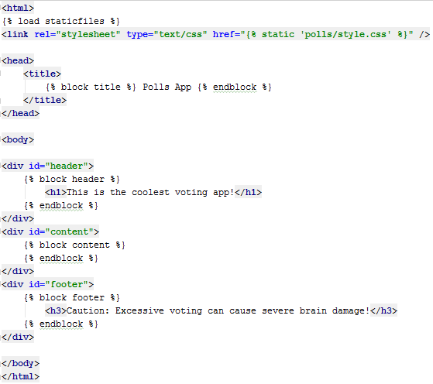
Defining a Base Template

Slide 88
Using the Base Template
Remove the {% load staticfiles %} and the ref to our stylesheet from our templates (index, detail, results)
Put {% extends "polls\base.html" %} in all of them
Right-shift the rest of the code and put it between the tags {% block content %} and {% endblock %}
Add the following line before {% block content %}
{% block title %} {{ block.super }} [fill] {% endblock %}
For index.html put Questions Page instead of [fill]
For detail.html put Question Details Page instead of [fill]
For results.html put Question Results Page instead of [fill]
Check out the new look & feel of our site!

